Slide 1
Ubiquitous and Mobile Computing CS 528: Magical Writer
Muxi Qi, Xuanyu Li, Chen Lin
Electrical and Computer Engineering Dept.
Worcester Polytechnic Institute (WPI)

Slide 2
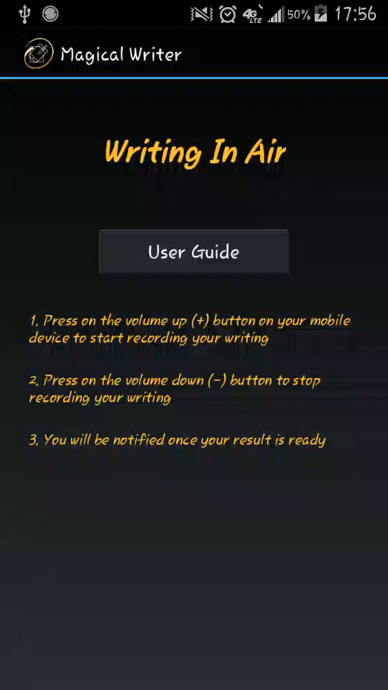
Introduction
Using built-in sensor to calculate the track of movement when you hold your phone trying to write something on air.
Saved as image.

Slide 3

App Info
App icon:
App name: Magical Writer
Objective: Using built-in sensors to record user gesture input and generate image output

Slide 4
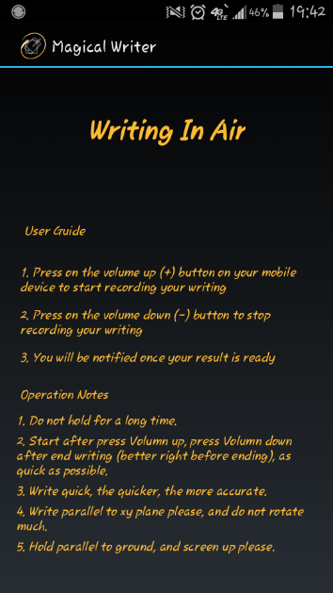
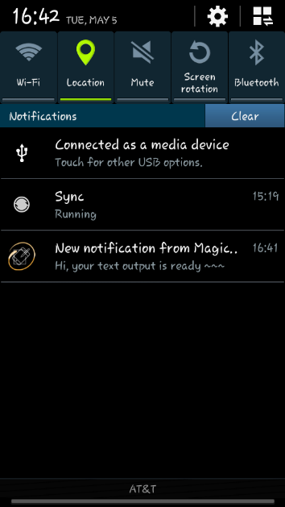

UI Views
Test version (this version)
Final version (UI not needed)
first activity
notification
result activity

Slide 5
UI Design Principal
Darker background
Ideally no UI
hardware button (work as switch)

Slide 6
UI Implementation
Thread separation
UI thread (Main thread)
Sensor event listener thread (Sensor monitor)
Background service thread (data interaction)

Slide 7
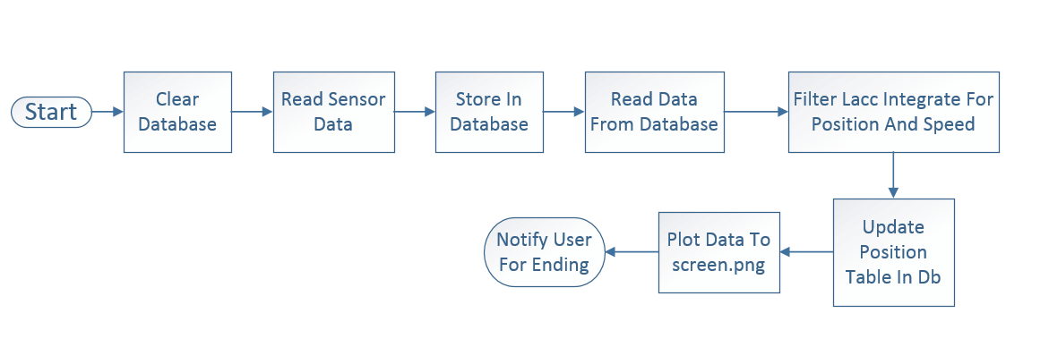
Flow Chart
Data Fetching
Data Processing
Image Saving

Slide 8
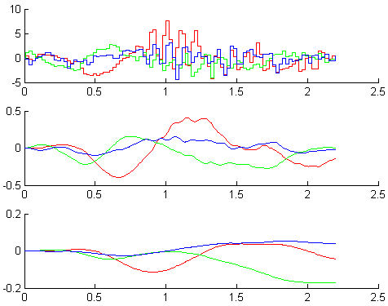
Data Processing
Filter Linear Acceleration to get rid of noise
White Noise
Drift Noise - Random Walk
Integrate Acceleration
for Instant Speed
Integrate Speed
for Instant Position

Slide 9
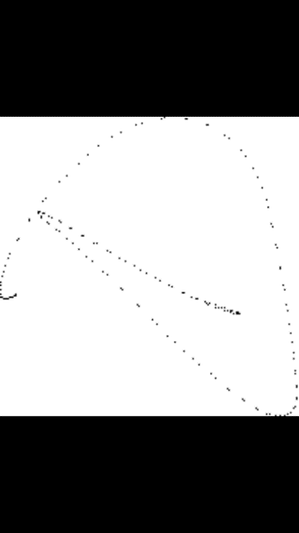
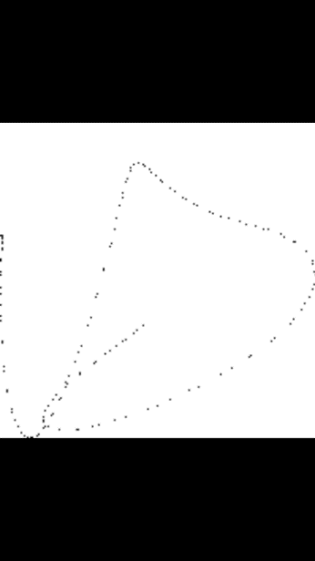
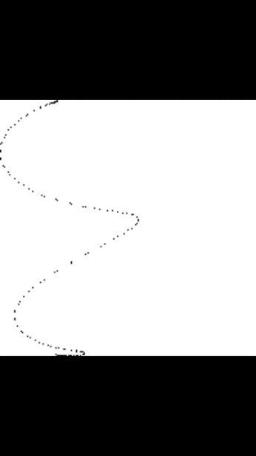
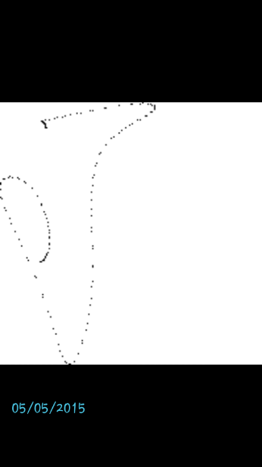

Result and Evaluation
Device: Samsung Galaxy S4 mini (black) (ver. 4.4.2)
Accuracy: 16/26 = 61%
Dependent on user operation: the faster the better
Only Letters without break tested and considered
A
D
E
J
W

Slide 10
References
http://developer.android.com/
Sandip Agrawal, Ionut Constandache, Shravan Gaonkar, Romit Roy Choudhury, Kevin Caves, and Frank DeRuyter. 2011. Using mobile phones to write in air. Proc. MobiSys 2011
Hsin-Hao Chiang. 2013. Magnetic Field Feature Analysis of Smartphone Application Activities Using Android MI Sensors
How Much Time Do We Really Spend On Our Smartphones Every Day? http://www.businessinsider.com.au/how-much-time-do-we-spend-on-smartphones-2013-6, JUN 6 2013
Students spend a lot of time Facebooking, searching, and texting. http://blog.reyjunco.com/students-spend-a-lot-of-time-facebooking-searching-and-texting, March 7, 2011

Slide 11
References
Maryam Ali, Muhammad Asim, Syed Hasan Danish, Farah Ahmad, Afsheen Iqbal, and Syed Danish Hasan. 2014. Frequency of De Quervain’s tenosynovitis and its association with SMS texting. Muscles Ligaments Tendons J. 2014 Jan-Mar; 4(1): 74–78.
Jeong Sook Park, Mi Jung Choi, Ji Eun Ma, Ji Hyun Moon, and Hyo Jeong Moon. 2014. Influence of Cellular Phone Videos and Games on Dry Eye Syndrome in University Students. J Korean Acad Community Health Nurs. 2014 Mar; 25(1):12-23, March 31, 2014
Hirsch H.G, Ehrlicher C. 1995. Noise estimation techniques for robust speech recognition. Acoustics, Speech, and Signal Processing, 1995. ICASSP-95., 1995 International Conference on (Volume: 1), 153 – 156, May 1995

Slide 12
QUESTIONS AND DISCUSSION
Questions?

Slide 13
Thank you!

